Slide 1
Bio-Medical Instrumentation
Prepared By: Mrs. Loveleena
(Lect.IC Department)

Slide 2
THANKYOU

Slide 3
ECG:-ELECTRO CARDIO GRAM
An ECG is a test that checks for problems in electrical activity of heart. It translates heart electrical activity into line tracing on paper and the machine by which ECG is recorded called Electrocardiograph.

Slide 4
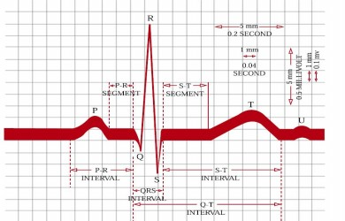
ECG Waveform

Slide 5
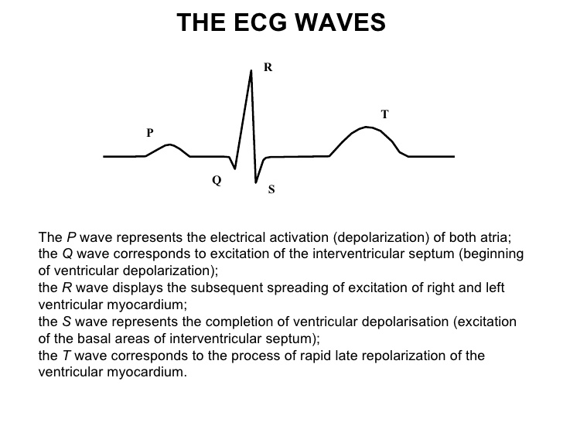

Slide 6
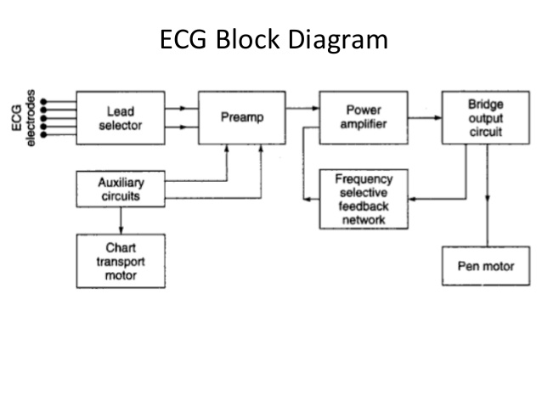
ECG BLOCK DIAGRAM

Slide 7
Advantages Of ECG

Slide 8
APPLICATIONS OF ECG

Slide 9
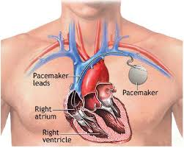
PACEMAKER

Slide 10
INTRODUCTION
Pacemaker is a device and its function is like a generator and electrical impulse gives to the heart for its to start beating again.
It is implemented under the skin and connects it to the heart through a wire.

Slide 12
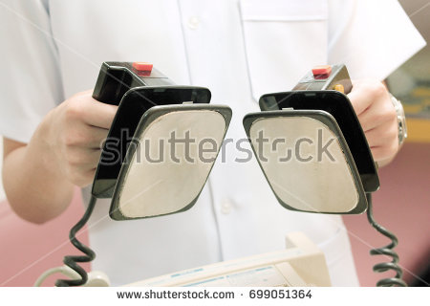
DEFIBRILLATOR

Slide 13
A defibrillator is a machine that can help when ventricular fibrillation happens in the heart of a human. A defibrillator is a life saving device. Fibrillation happens when many different cells in the heart begin to act as pacemaker cells.
Defibrillation is a technique used in emergency medicine to terminate ventricular fibrillation or pulses ventricular tachycardia. It uses an electrical shock to reset the electrical state of the heart so that it may beat to a rhythm controlled by its own natural pacemaker cells.
Defibrillation is a medical technique used to counter the onset of ventricular fibrillation, (VF) a common cause of cardiac arrest, and pulses ventricular tachycardia, which sometimes precedes ventricular fibrillation but can be just as dangerous on its own.

Slide 14
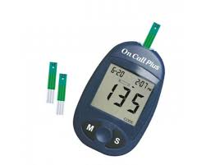
GLUCOMETER
A glucose meter is a medical device for determining the approximate concentration of glucose in the blood. It can also be a strip of glucose paper dipped into a substance and measured to the glucose chart. It is a key element of home blood glucose monitoring (HBGM) by people with diabetes mellitus or hypoglycemia. A small drop of blood, obtained by pricking the skin with a lancet, is placed on a disposable test strip that the meter reads and uses to calculate the blood glucose level. The meter then displays the level in units of mg/dl or mmol/l.

Slide 15
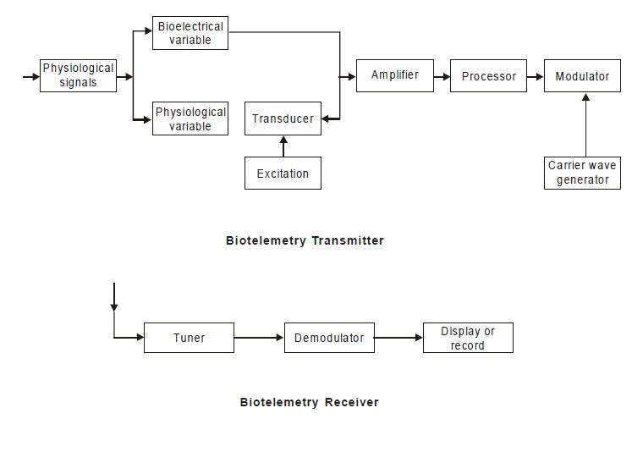
BIOTELEMETRY

